Slide 1
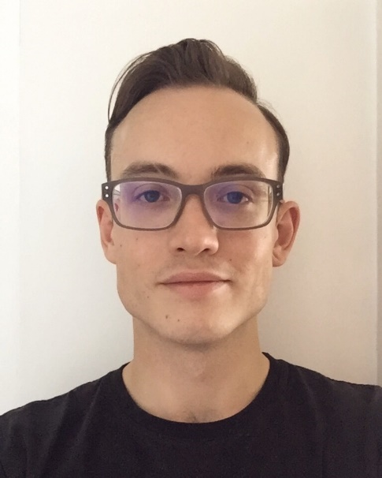



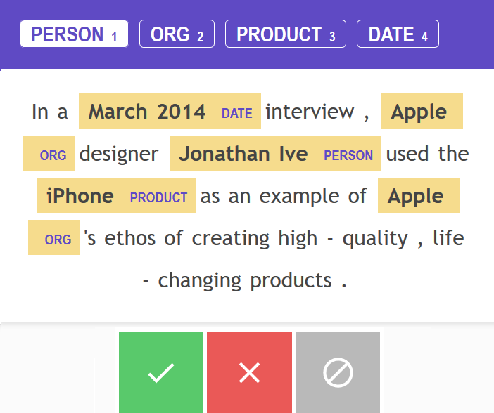








Alexander Downing
Computer Science
HUMAN-CENTRIC APPROACHES TO LANGUAGE MODELLING AND ANNOTATION FOR NAMED ENTITY RECOGNITION TASKS
Problem Overview:
Supervised Machine Learning (ML) techniques require a supply of data that is generally representative of the application domain. Therefore, it is widely accepted that models cannot be reliably produced without appropriately annotated datasets.
Aside from data integration, the notion of data worthiness is a key issue facing some sectors of industry. Often led by lucrative information-intensive marketplace behaviours, attempts to leverage and valorise material amassed in industrial silos can be challenging but rewarding. Without proper forethought, retrospectively poor standards of infrastructural data management typically result in data being suboptimal for supervised learning tasks. To rectify this, large-scale annotation projects must be undertaken. Generally, such a venture comes at great cost and effort, due to the arduousness of the task and sole reliance on human arbitration.
This scenario is a conventional starting point for most Natural Language Processing (NLP) tasks, where a set of correctly identified observations is required before modelling can take place. For structured prediction problems, such as Named Entity Recognition (NER), these observations need to be recorded at the word-level, normally making the task of annotating a dataset for this purpose more gruelling.
Objectives & Design:
The broad objectives are as follows:
Produce a platform agnostic annotation system.
Extend upon state-of-the-art by offering a novel and graphical approach to text representation and similarity sampling.
Maximise both the productivity and investigative potential of the user.
Incorporate active learning and measures of uncertainty to improve modelling outcome.
Sentence representation
Doc2Vec
Background & State-of-the-Art:
Annotation methods exist but are often slow, closed loops. Systems may allow users to provide annotations, but offer no way of imposing knowledge aside from agreeing or disagreeing with exemplar statements.
Prodigy, a recent offshoot of the popular open source NLP software library spaCy, combines powerful NLP functionality with an annotation interface. General-purpose pretrained models (built from GloVe, and OntoNotes) underline spaCy/Prodigy’s NER capability, which can be trained to introduce custom entities via the annotation process [1].
One draw back of this system is that separate annotation sessions are required per each individual target entity. Therefore, no more than one entity can be annotated at a time, despite different entities appearing close together in the vector space users' sample from.
Corpus
Discharge dataset
Word representation
Annotate in context
Word2Vec
Uncertainty Sampling
Discharge tagger
Search terms
Sequence Model
Plot vector space
Fig 1. Example of Prodigy’s annotation interface. Tokens can be annotated after selecting one of the entity choices above, then clicking the corresponding token.
Annotate entity boundaries
Clustering
Fig 2. High-level system overview.
Suggest structure

Slide 2
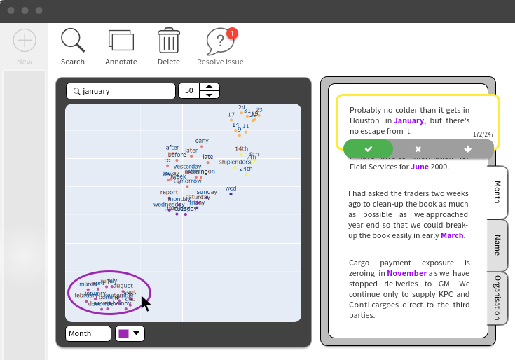
Alexander Downing
Computer Science
HUMAN-CENTRIC APPROACHES TO LANGUAGE MODELLING AND ANNOTATION FOR NAMED ENTITY RECOGNITION TASKS
Architecture:
Text representation:
The system generates paragraph embeddings using the Distributed Memory (PV-DM) approach to Doc2Vec [2]. This enables for similarity between sentences to be computed, whilst also generating word level embeddings in the process. Similarly, word embeddings are used for the entity search, and comprise the input features to the sequence model.
Unsupervised methods:
Along with the text representation, unsupervised methods are used to facilitate 2D views of the vector space. Principle Component Analysis (PCA) and Uniform Manifold Approximation and Projection (UMAP) [3] are computed once a region is defined by the user’s search.
Points are clustered using the Ordering points to identify the clustering structure (OPTICS) algorithm [4], which detects density-based structures within the word embeddings, highlighting areas of interest to the user.
Similarity measures:
Cosign measures are used to attain documents and words for comparison and annotation. Returned values fall within a positive and negative range, so to denote degrees similarity and dissimilarity.
Term frequency-inverse document frequency (tf-idf) vectors computed via the document embeddings give rise to a set of significant words, which can be used as a starting point when beginning an entity search.
Annotations and entity neighborhoods:
Once located, areas within the vector space that contain entities can be annotated by the user. Within the space, semantically similar entities appear close to one another, and therefore can be bounded into regions. Doing so assigns all captured points with the entity tag.
If new data is introduced into the Doc2Vec model, points which fall within these regions are automatically associated with the entity tag, prompting the user for validation.
Sequence model:
Although still in development, a bidirectional LSTM variant [5] is anticipated to fulfil the final NER modeling requirements.
Given the interactive nature of the system, the incorporation of Active Learning approaches such as uncertainty sampling are also planned, allowing the system to prompt the user to annotate a given instance that presents greater challenge.
Web Application:
Fig 3. Mock-up design of the application, centring around the search and annotation views. The former is used to explore and target entities within the word space, where the latter shows the chosen entitles in context during an annotation session.

Slide 3




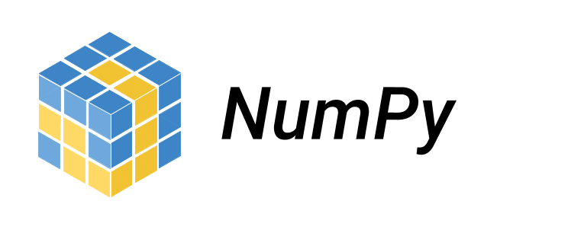







Alexander Downing
Computer Science
HUMAN-CENTRIC APPROACHES TO LANGUAGE MODELLING AND ANNOTATION FOR NAMED ENTITY RECOGNITION TASKS
Project Plan & Milestones:
Met:
Implemented and evaluated the applicability of a variety of NLP technologies to meet the fundamental project aims.
Defined a global overview of the system, and developed a scaffolding to both front and backend of the web application.
Future:
Incorporate modelling workflow, and active learning procedures to system.
Mature both the document and word similarly measures.
Incorporate a wider variety of options for projecting and investigating the data.
Develop session analytics and report progress, such as, number of annotations per entity.
Find more tangible approach to generating suggestions regarding areas of interest to the user, replacing the tf-idf approach.
Improve overall runtime.
Potential:
Develop ways of streaming data into the system.
Offer togglable options for text pre-preprocessing.
Generalise approach to enable an assortment of annotation tasks aside from NER, for example, document classification.
Technologies Used:
[1] "Prodigy · An annotation tool for AI, Machine Learning & NLP", Prodigy, 2020. [Online]. Available: https://prodi.gy/. [Accessed: 29- Jan- 2020]
[2] Q. Le and T. Mikolov, "Distributed Representations of Sentences and Documents", arXiv.org, 2014. [Online]. Available: https://arxiv.org/abs/1405.4053. [Accessed: 29- Jan- 2020].
[3] L. McInnes, J. Healy and J. Melville, "UMAP: Uniform Manifold Approximation and Projection for Dimension Reduction", arXiv.org, 2018. [Online]. Available: https://arxiv.org/abs/1802.03426. [Accessed: 29- Jan- 2020].
[4] "OPTICS | Proceedings of the 1999 ACM SIGMOD international conference on Management of data", Dl.acm.org, 1999. [Online]. Available: https://dl.acm.org/doi/10.1145/304182.304187. [Accessed: 29- Jan- 2020].
[5] Z. Huang, W. Xu and K. Yu, "Bidirectional LSTM-CRF Models for Sequence Tagging", arXiv.org, 2015. [Online]. Available: https://arxiv.org/abs/1508.01991. [Accessed: 29- Jan- 2020].
.

